Slide 1


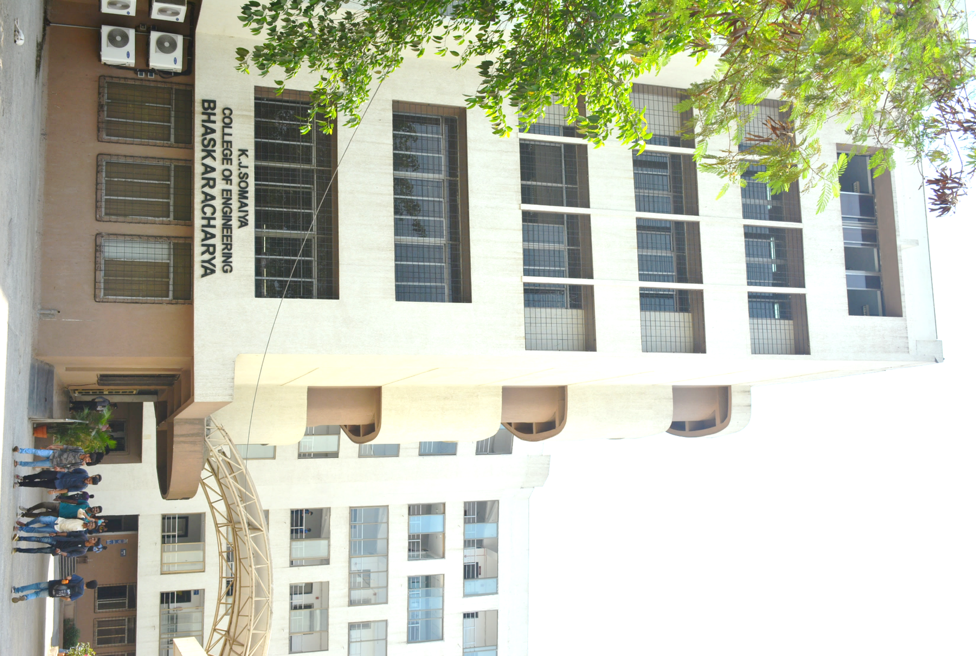
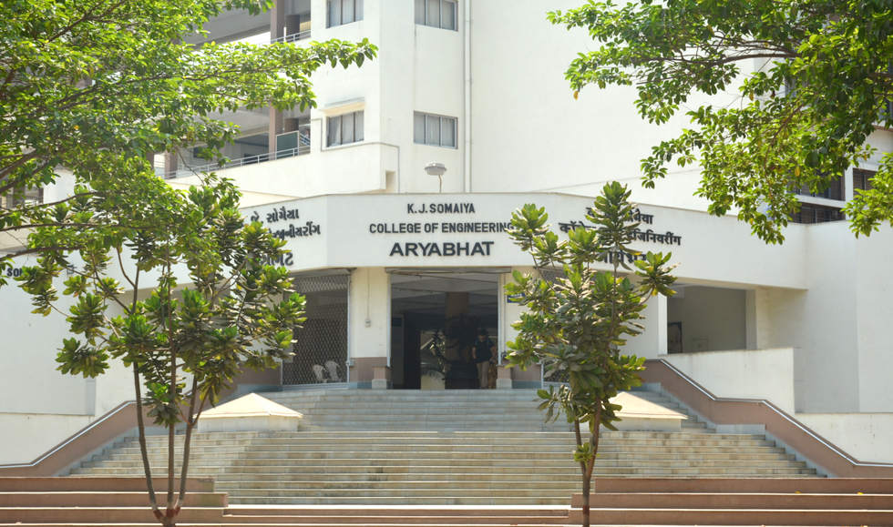
ThermoAQ
16010123012- Aaryan Sharma
16010123017- Aditey Kshirsagar
16010123023- Aditya Baheti
1

Slide 2
Objective
Deliver real-time, district-level alerts for heat waves and air quality in India.
Help users make safer decisions with personalized risk warnings and health tips.
Visualize environmental data in a clear, user-friendly dashboard.
Raise awareness about weather and pollution risks.
2

Slide 3

Tech Stack
FrontEnd: React 19, Vite, Tailwind CSS, Lucide React Icons
BackEnd: Node.js, Express.js
Database: MongoDB (with Mongoose ODM)
3

Slide 4
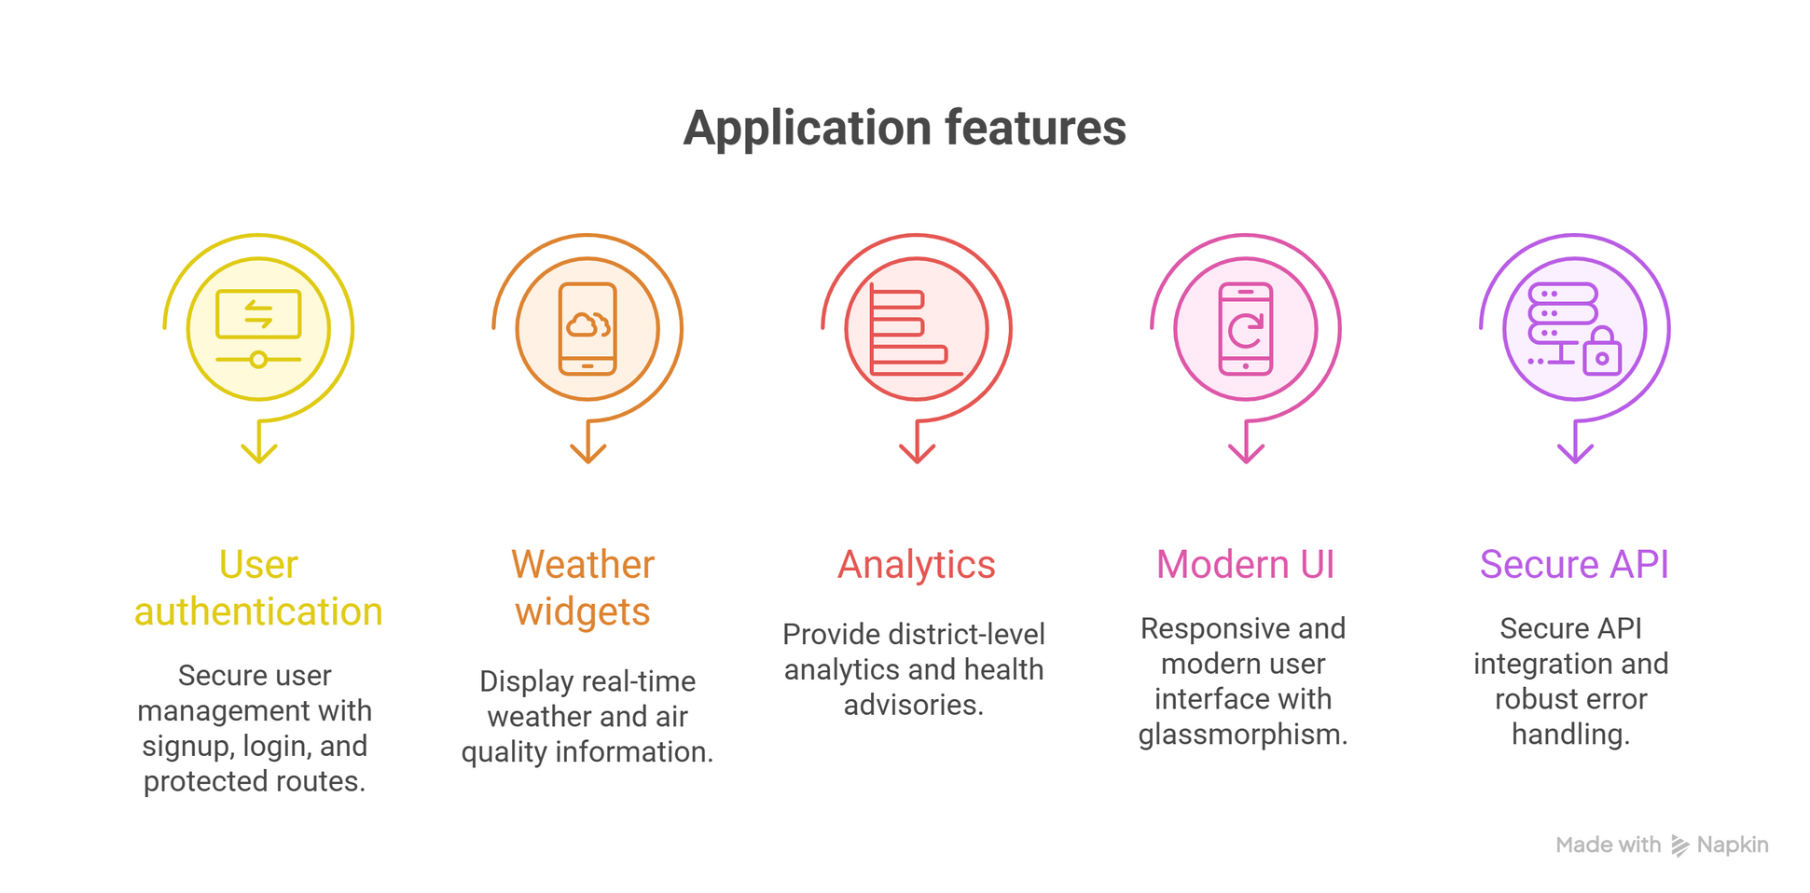
Key Features
4

Slide 5
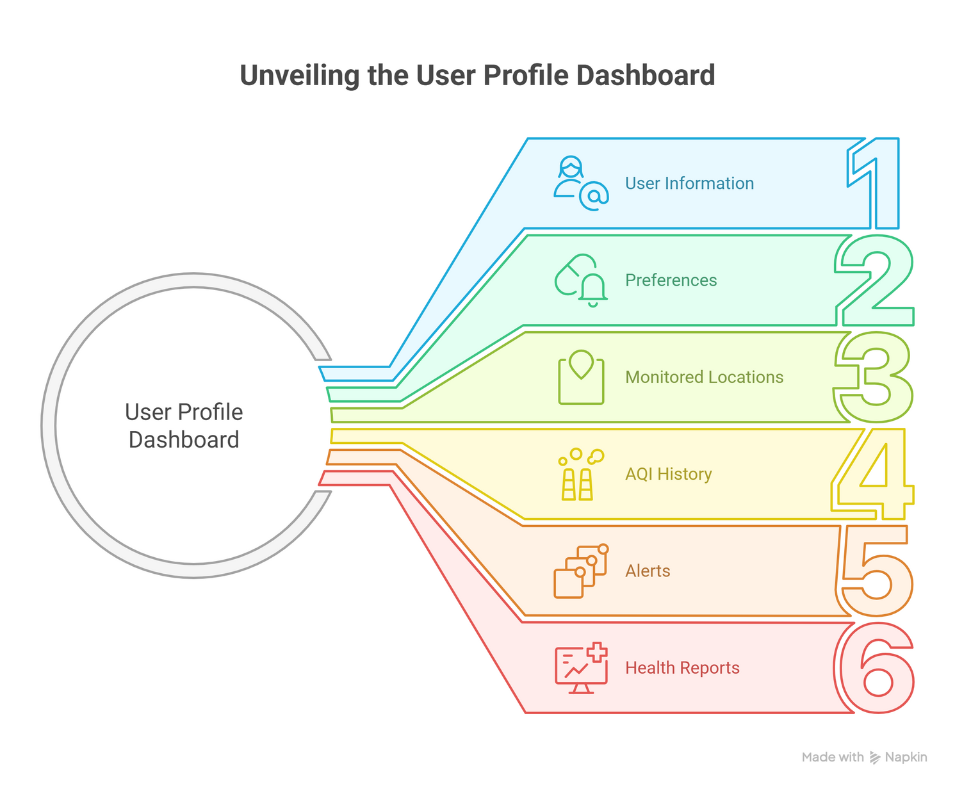
Database Design
5

Slide 6
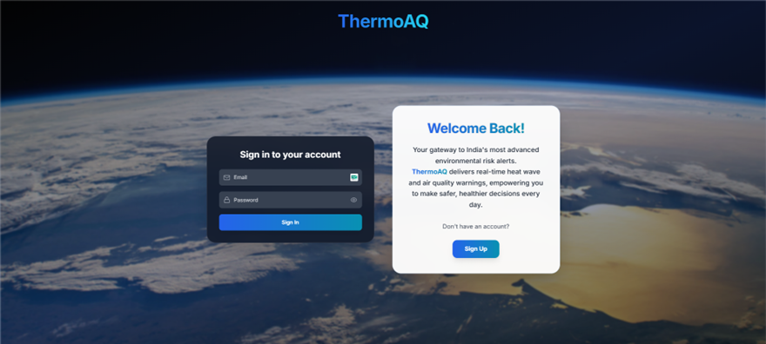
Highlights
7

Slide 7
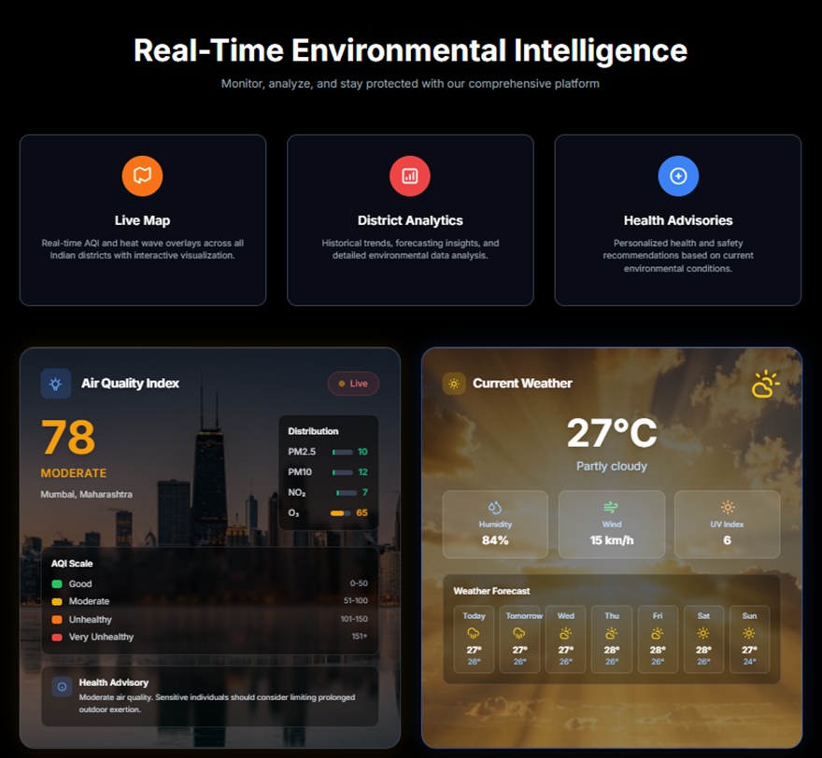
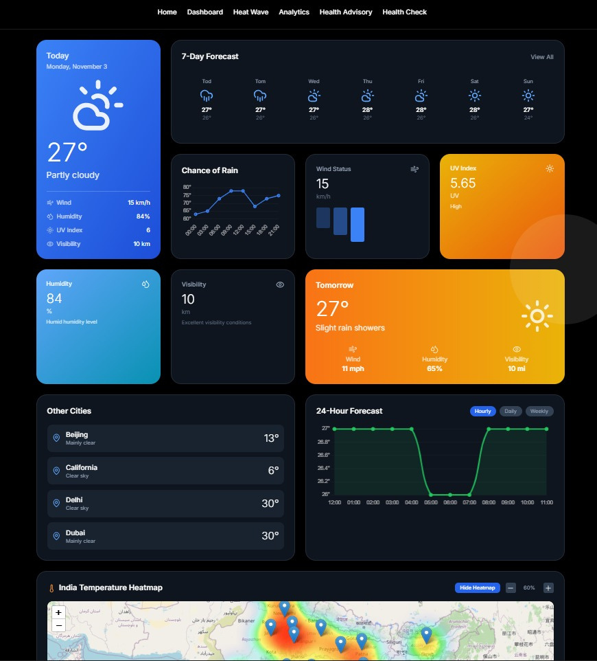
Highlights
7

Slide 8
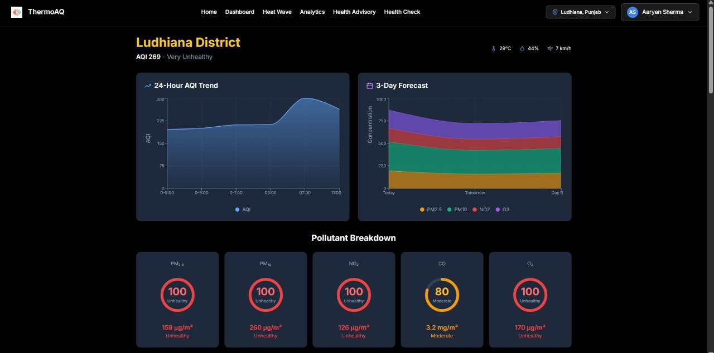
Highlights
7

Slide 9
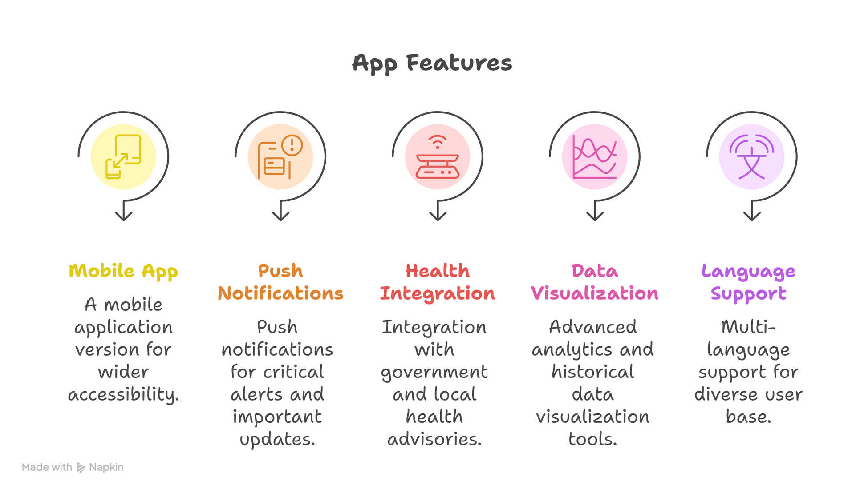
Future Scope
6

Slide 10
Thank You
14

